Slide 1
Setting up a web server
MAMP/WAMP

Slide 2
MAMP and WAMP
WAMP: Windows Apache MYSQL and php
MAMP: Mac Apache MYSQL and php

Slide 3
Components
Apache is the web server
Mysql is a relational database management system
PHP is a server side scripting language

Slide 4
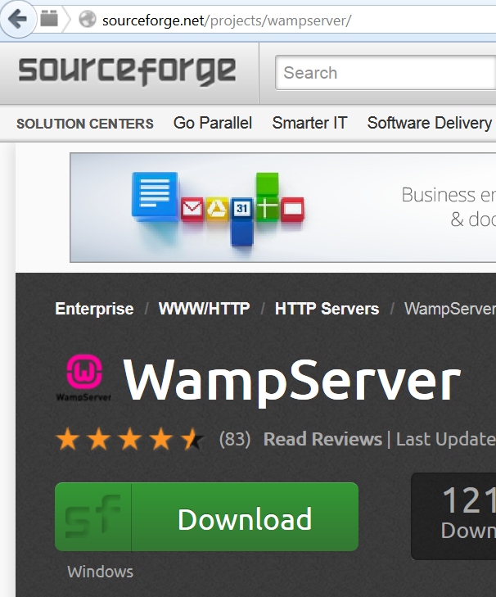
WAMP is downloaded from Sourceforge

Slide 5
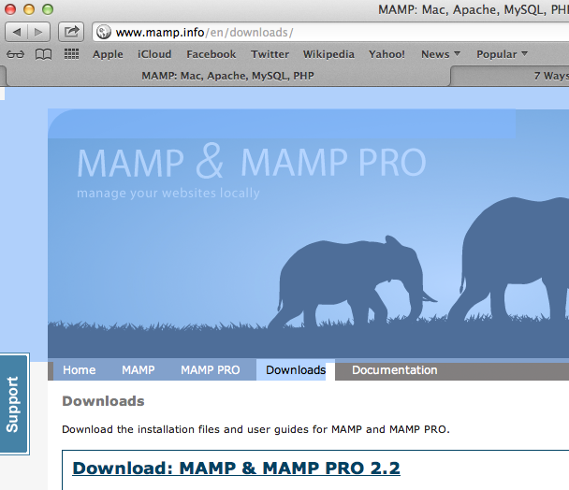
MAMP is downloaded from mamp.info

Slide 6
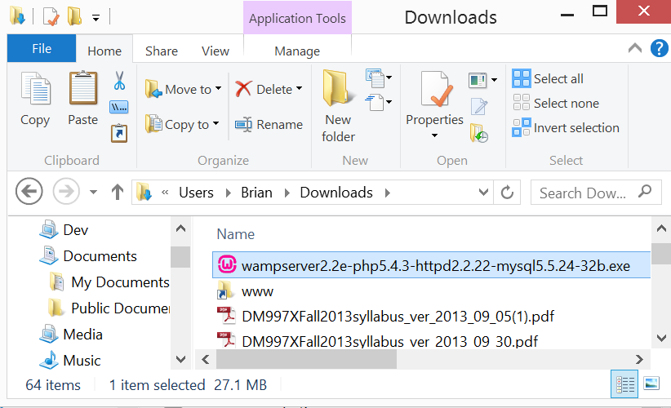
Windows Setup
Click on the self-extracting archive

Slide 7
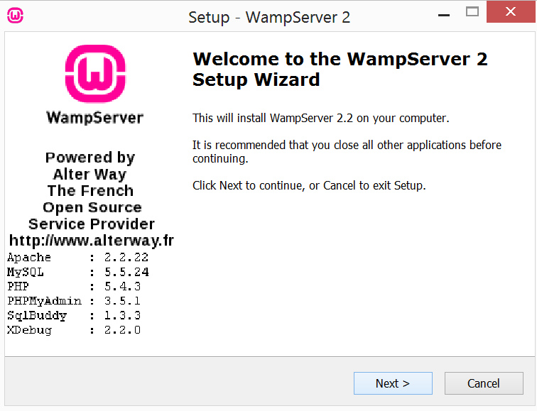
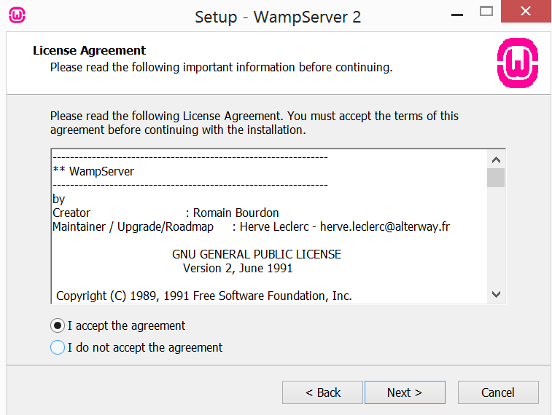
Windows Setup

Slide 8
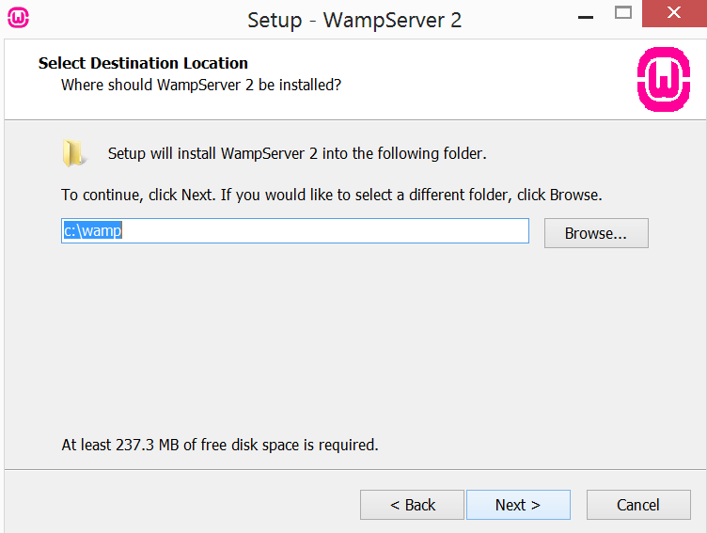
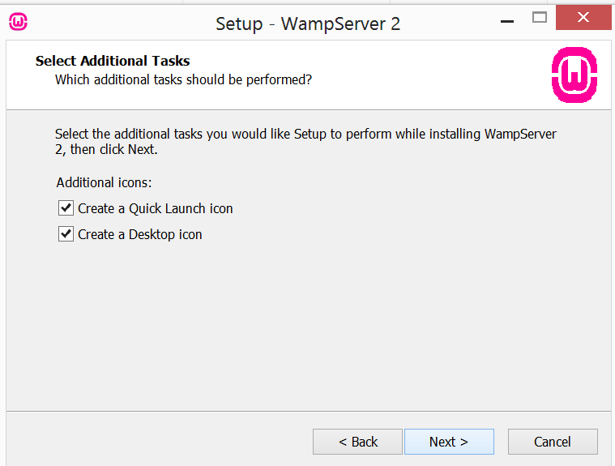
Windows Setup

Slide 9
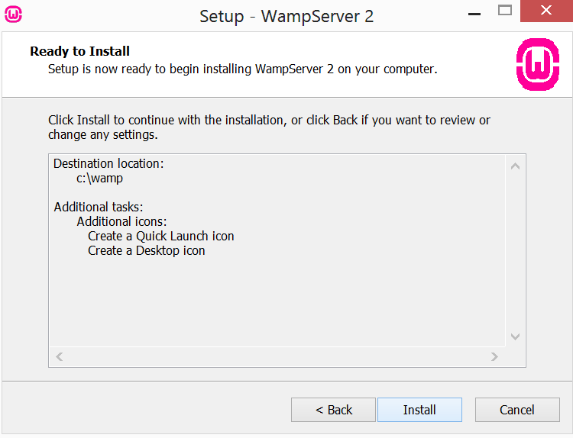
Windows Setup

Slide 10
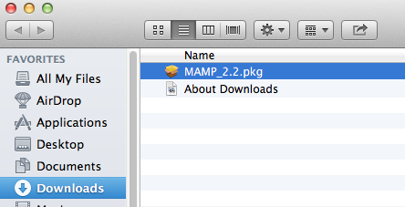
Mac Setup

Slide 11
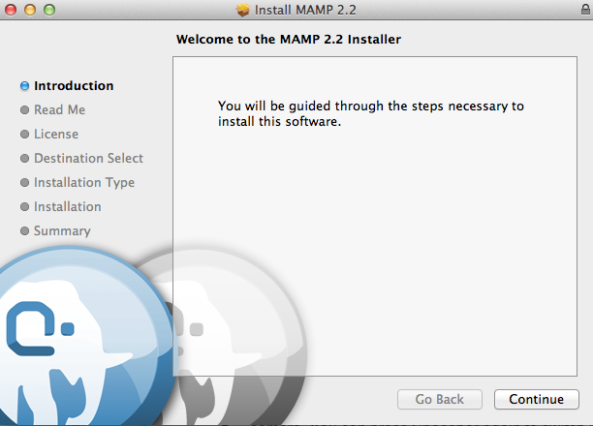
Mac Setup

Slide 12
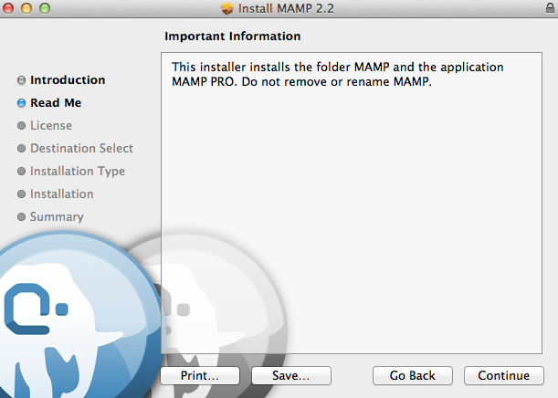
Mac Setup

Slide 13
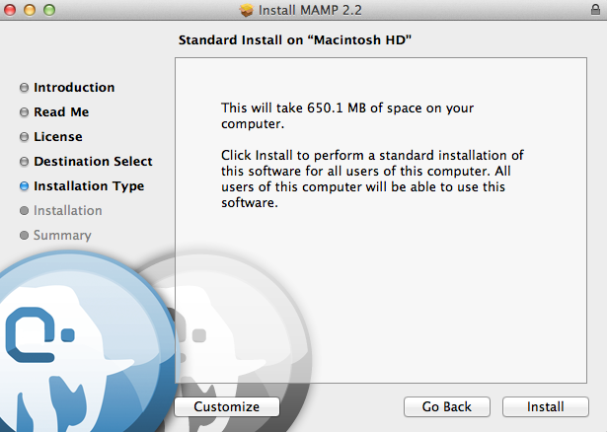
Mac Setup

Slide 14
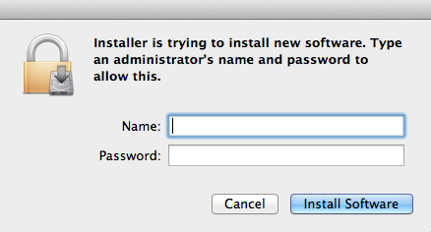
Mac Setup

Slide 15
Mac Setup
Copy dmg file to Applications folder.

Slide 16
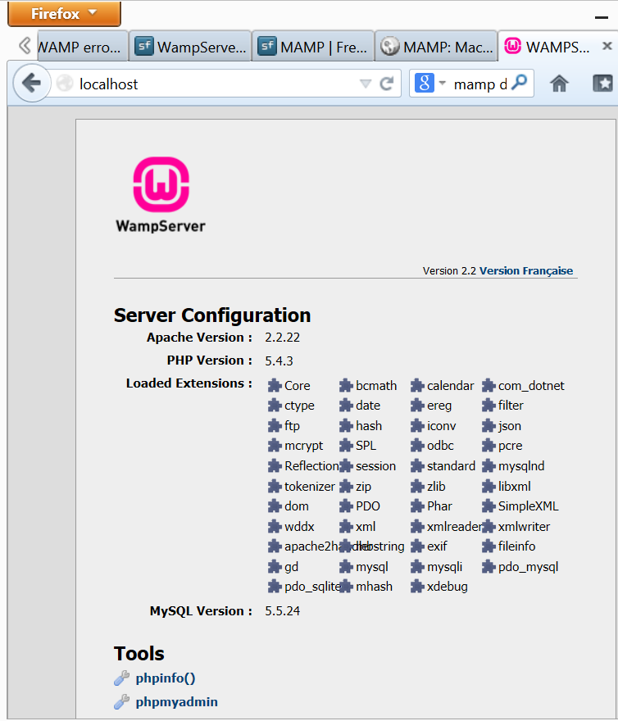
Launch!

Slide 17
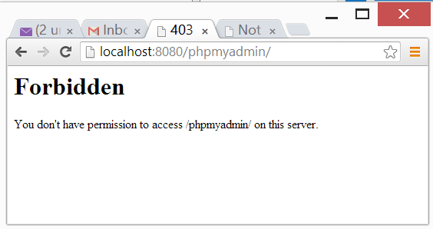
Restrictive Permissions
By default permissions are restrictive. If you cannot access the dashboard page by typing localhost (or localhost:nn If you are using a non-default port) you may need to alter your server configuration file.

Slide 18
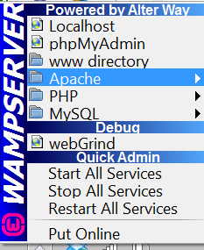
The WAMPSERVER Control Panel
The WAMPserver control panel is launched by the green W icon on the taskbar.
Use it to start and stop the server, and to edit configuration files

Slide 19
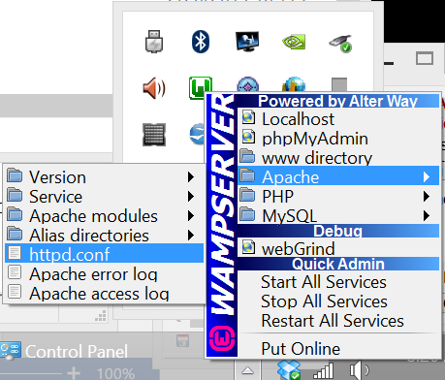
Editing the httpd.conf File
Select Apache / httpd.conf from the WAMPSERVER control panel to edit the httpd.conf file.

Slide 20
Editing the Apache httpd.conf File
<Directory "c:/wamp/apps/phpmyadmin3.4.5/">
Options Indexes FollowSymLinks MultiViews
AllowOverride all
Order Deny,Allow
Allow from all
</Directory>

Slide 21
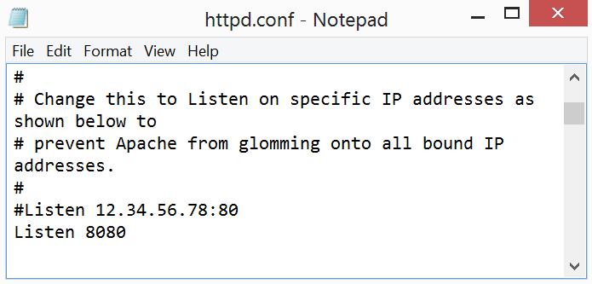
Changing Ports in httpd.conf
By default the Apache webserver listens for requests on port 80. This frequently causes conflicts with other software, for example Skype.

Slide 22
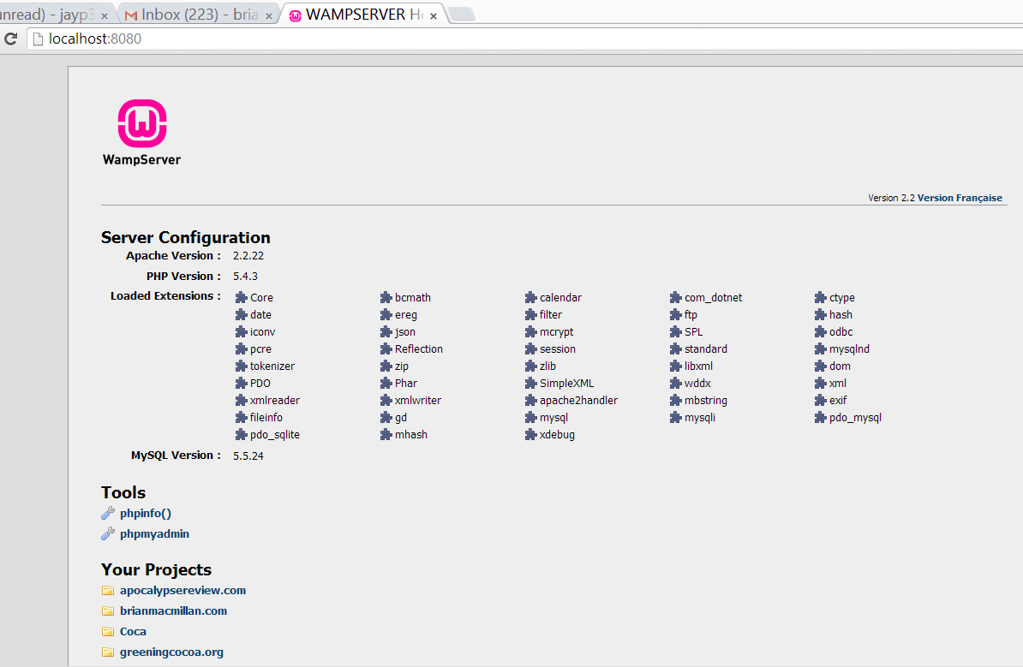
Configuring the Server

Slide 23
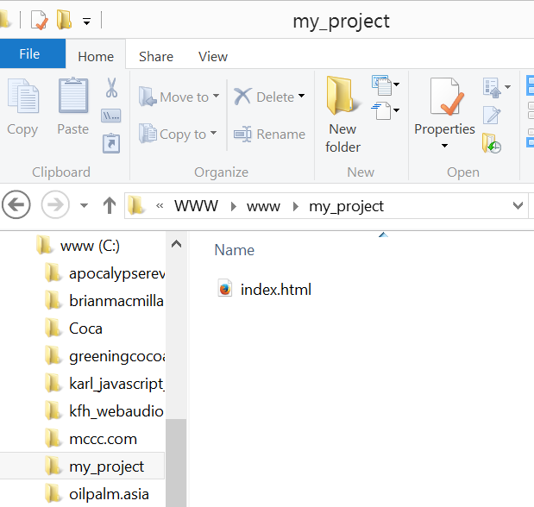
Launching a Webpage
Create a project folder in your web folder (httdocs on the Mac, the www folder in Windows.
Create an html file called index.html and place it in the project folder

